Slide 1
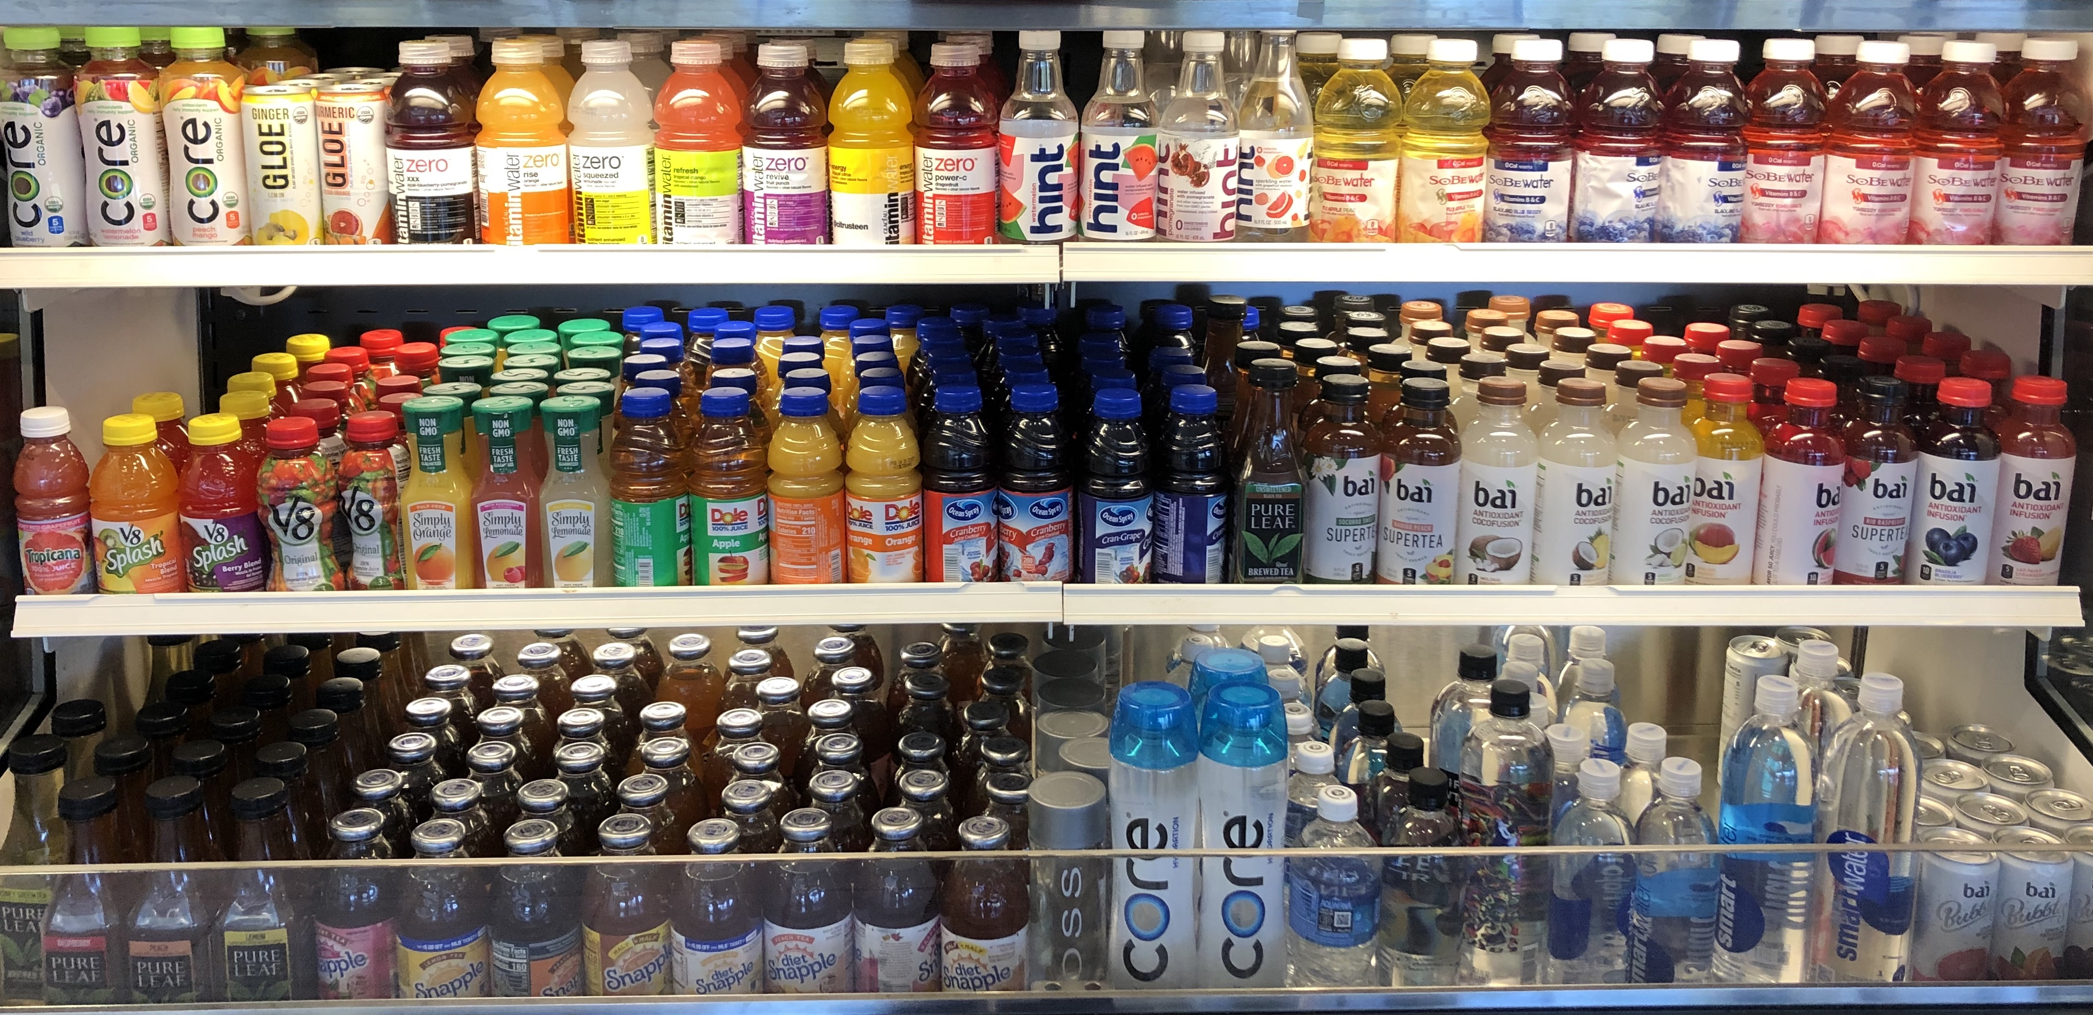
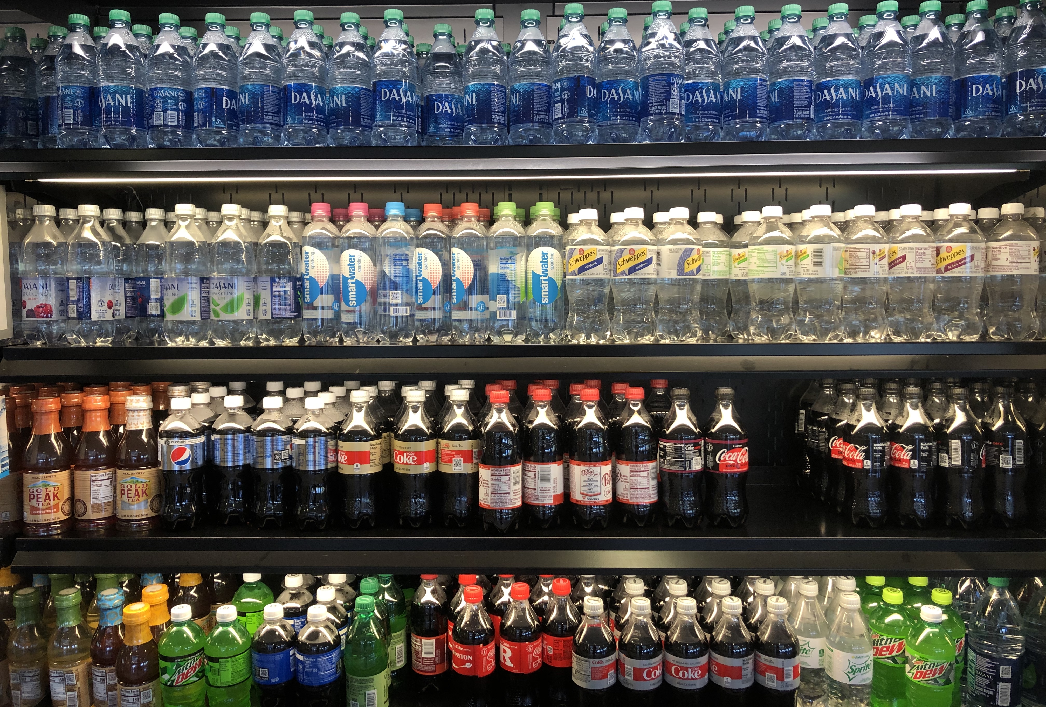
Factors Influencing Consumer Cold Beverage Choices in the Café
Amy Wagner, Claudia Gray, RDN, Michelle Sagristano, MS, RDN
Johnson & Johnson Spring House and Fort Washington, PA
Email: AW844382@wcupa.edu
ABSTRACT
The obesity epidemic is threatening the health of our population which is why it is so important to take a closer look at the nourishment with which we fuel our bodies. A significant and important part of our diet is beverage consumption. The incorporation of healthy beverages has a significant impact on our health and our bodies in a positive way, much like sugar-sweetened unhealthy beverages has a significant impact on our health and our bodies in a negative way.
The study done in 2018 by the Public Health Nutrition Journal, ” Consumption of sugar-sweetened and artificially sweetened soft drinks and risk of obesity-related cancers”, researchers studied the frequency of consumption of sugar-sweetened soft drinks related to increased risk of obesity- related cancers. The cohort study observed 41,514 men and women between the ages of 40 and 69 over the time period of 1990- 1994 and again from 2003-2007. The results of the study concluded that participants who “increased their frequency and consumption of both sugar- sweetened and artificially sweetened soft drinks were associated with greater waist circumference at baseline”. This study also showed that “the hazard ratio for obesity- related cancers increased as consumption of [sugar-sweetened beverages] increased”.¹
In another study done in 2019 by the Diabetes Care Journal, “Changes in Consumption of Sugary Beverages and Artificially Sweetened Beverages and Subsequent Risk of Type 2 Diabetes: Results From Three Large Prospective U.S. Cohorts of Women and Men”, analyzed the relationship of the consumption of sugary beverages and 100% fruit juices with risk of type 2 diabetes. The study analyzed 76,531 women in the Nurses’ Health Study from 1986-2012, 81,597 women in the Nurses’ Health Study from 1991-2013, and men in the Health Professionals’ Follow up Study from 1968-2012. The results of this study showed that “increasing total sugary beverage intake by >0.50 serving/day over a 4-year period was associated with a 16% higher diabetes risk in the subsequent 4 years”.²
LEARNING OUTCOME
To provide Johnson & Johnson with feedback regarding popular consumption of cold beverages sold in the café. This information can be used to increase healthier beverage choices available to customers in the café.
RESULTS / DISCUSSION
The results of the study showed that the top three reason customers choose their beverages are based off of 1) Taste, 2) & 3) Nutrition and Habit. The most popular beverage chosen daily by participants was bottled water. The most popular beverage chosen 1-2 x week by participants was also bottled water. The most popular beverage chosen 3-4 x week by participants was tied for three drinks: 100% fruit or vegetable juice, bottled sweetened tea, and bottled diet tea. The most popular beverage chosen 4-6 x week by participants was also bottled water. The top beverage never consumed was regular sports drinks.
Overall it is clear that the majority of participants gravitated towards the consumption of healthier beverage options from the café at both J&J sites. The reason behind this could be influenced by the Health Force 2020 initiative moving towards the elimination of unhealthy sweetened beverages sold in the café at all J&J sites, however it is still unclear if this is a significant influence.
METHODS / STRATEGIES
Data was collected on a total of 30 customers from the café at Johnson and Johnson sites. Data was collected from two J&J sites; 15 customers from Spring House J&J, and 15 customers from Fort Washington J&J over the course of two separate lunch periods. Participants for this research were selected on a volunteer basis.
Of the 30 participants, 20 were female and 10 were male. There were 2 participants under 20 years of age, 3 participants between 21 and 30 years of age, 7 participants between 31 and 40 years of age, 12 participants between 41 and 50 years of age, 4 participants between 51 to 60 years of age, and 2 participants over the age of 60. Of the 30 participants 2 received the highest education of earning a High School diploma, 16 received the highest education of earning a Bachelors, 6 received the highest education of earning a Masters, and 6 received the highest education of earning a Doctorate. Twenty-three participants were J&J employees, 5 participants were contracted employees, and 2 were food serviced employees.
Participants were given a survey to fill out regarding their consumption and frequency of purchasing cold beverages from the café as well as their reasons for purchasing the beverages. Participants also were required to fill out their personal information as well on each survey. The Dietetic Intern orchestrated and collected all data from each site in an excel spread sheet. There was no control for this study.
For frequency of beverage consumption, participants had the option to choose the following for 17 separate cold beverages sold in the café: never (0); daily (1); 1-2 x week (2); 3-4 x week (3); or 4-6 x week (4).
CONCLUSION
The results of the study proved that participants from both J&J sites combined chose to purchase healthier beverages over unhealthy sugar sweetened beverages. However, It cannot be proved that the results are due to the Health Force 2020 initiative to eliminate all sugar sweetened beverages by 2020. It is inconclusive as to why healthier beverage choices are being purchased more frequently by participants, but it is found that participants did choose healthier beverage options.
RECOMMENDATION FOR FUTURE RESEARCH / LIMITATIONS
For future research I recommend using 30 participants from three J&J sites each, totaling 90 participants for the study. This study should be targeted toward either male of female customers in order to rule out unnecessary variables, or collect data evenly between the two genders at each site. Due to Health Force 2020 many of the beverages listed for this research will no longer be sold in the marketplace, therefore, it would be beneficial to conduct a study of beverages that participants consume overall and not just from the café. A limitation of the study would be that the participants could be dishonest about their consumption of beverages. Another limitation would be that the data collected for this research was collected at two separate meals: Spring House during lunch and Fort Washington during breakfast. This could have effected the beverage choices of the customers. Another study should be done by collecting data from the same meal period for all data collection.
REFERENCES
1. Hodge A, Bassett J, Milne R, English D, Giles G. Consumption of sugar-sweetened and artificially sweetened soft drinks and risk of obesity-related cancers. Public Health Nutr. 2018;21(9):1618-1626. doi:10.1017/s1368980017002555
2. DROUIN-CHARTIER J, ZHENG Y, LI Y et al. 152-OR: Changes in Consumption of Sugary Beverages and Artificially Sweetened Beverages and Risk of Type 2 Diabetes among U.S. Women and Men. Diabetes. 2019;68(Supplement 1):152-OR. doi:10.2337/db19-152-or
3. Informatics D. Pennsylvania County Health Profiles. Health.pa.gov.https://www.health.pa.gov/topics/HealthStatistics/VitalStatistics/CountyHealthProfiles/Documents/current/Montgomery.aspx. Published 2017. Accessed October 20, 2019.
INTRODUCTION / BACKGROUND
Beverages are a significant component to the health of our nation because they provide us with the adequate hydration we need to support our body and body functions. It is important to focus on the consumption of healthy beverages in the workplace rather than unhealthy sugar sweetened beverages. In Montgomery County 79.9% of the population is white, 9.8% is black; 8% is Asian/ Pacific Islander; and 5.2% is Hispanic. The Pennsylvania County Health Profiles in 2017 for Montgomery County lists that 63% of the county is overweight, 26% is obese, and 9% have ever been told they have DM.³ Because of these statistics it is important for the community to put an emphasis on consuming naturally flavored healthy beverages, as opposed to beverages that contain extra calories, artificial sweeteners and added sugars. By phasing out sugar sweetened beverages with added sugar via Health Force 2020 standards, Compass moves towards a healthier workplace that promotes health and wellness in the beverage choices of their customers.
The objective of this research is to analyze the beverages purchased by customers in the J&J café at Spring House and Fort Washington sites. It is hypothesized that because there is a strong health initiative towards healthy beverage consumption due to Health Force 2020, most customers will choose to drink healthier beverages over sugar sweetened beverages.
Notes:
For Consumer Cold Beverage Choices in the Café Chart :
1. Bottled Water
2. Sparkling/ Flavored Water
3. 100% Fruit or Vegetable Juice
4. Sweetened Juice Beverages
5. Soft Drinks, Sweetened
6. Diet Soft Drinks
7. Regular Energy Drinks
8. Sugar-Free Energy Drinks
9. Regular Sport Drinks
10. Zero Calorie Sport Drinks
11. Bottled Cold Brew Coffee
12. Bottled Sweetened Tea
13. Bottled Diet Tea
14. Whole Milk
15. 2% or Skim Milk
16. Chocolate Milk
17. Non-Dairy Milk
18. Other Beverage: Coffee

