Slide 1
Inborn Error: Isovaleric Acidemia
Sydney Mitcheltree, Samantha Mckee, Amy Wagner and Cate Zuccarello

Slide 2
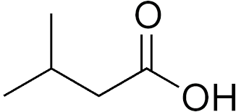
Classification/ Definition
Isovaleric Acidemia (IVA):
Also referred to as Organic Acidemia or Organic Aciduria
Can be Toxic
Organic Acidemia:
Abnormal levels of organic acid in blood
Organic Aciduria:
Abnormal levels of organic acid in urine
Organic acid→ metabolic disorder that results in difficulty and problems with catabolizing the branched chain amino acid leucine.
Leucine is a ketogenic AA.
Metabolic Acidosis
Cause build up of acids→ more acidic blood

Slide 3
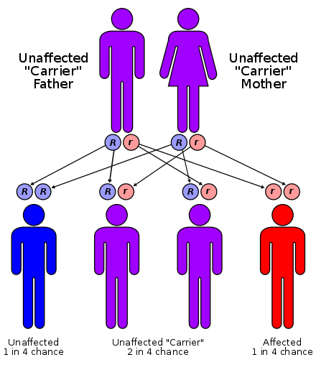
Pathophysiology
Autosomal recessive pattern of inheritance
In each cell, both copies of the gene has mutations
Mutations in IVD gene cause isovaleric acidemia
IVD codes for making of enzymes that are responsible for breaking down proteins.
Inadequate levels of the enzyme Isovaleryl Coenzyme A (CoA) dehydrogenase that is needed in order to catabolize the amino acid leucine.

Slide 4
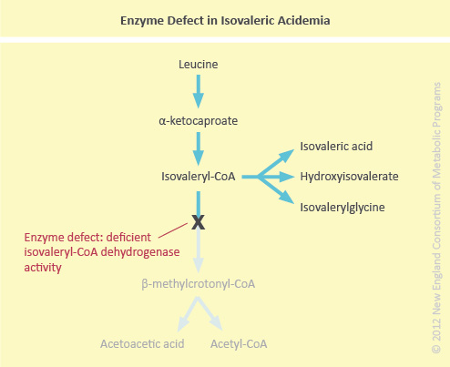
Enzyme Defect:
Isovaleric Coenzyme A (CoA) Dehydrogenase

Slide 5
Leucine Metabolism in Isovaleric Acidemia

Slide 6
Manifestation
Range from mild to life-threatening
Symptoms occur within a few days after birth
Initial symptoms:
Poor appetite
Vomiting
Seizures
Lack of energy
Characteristic sign: distinctive odor of “sweaty feet” during acute illness due to build up of isovaleric acid

Slide 7
Manifestation Continued
Symptoms appear during childhood and may come and go over time
Episodes of more serious health problems can be triggered by prolonged periods without food (fasting), infections, or eating an increased amount of protein-rich foods

Slide 8
Diagnosis
Diagnosed before birth through amniocentesis by measuring the concentration of abnormal metabolites in amniotic fluid or the activity of the isovaleryl-CoA dehydrogenase enzyme in fluid or tissue samples
In infants, the disorder is diagnosed in the first weeks of life, based upon a thorough clinical evaluation and a variety of specialized tests.
Laboratory studies are typically conducted on urine and plasma concentrations
Not a mandatory routine screening

Slide 9
Epidemiology
Isovaleric acidemia is estimated to affect at least 1 in 250,000 people (babies) in the United States
Prevalence of symptoms:
80-99% have global developmental delay & metabolic acidosis
30-79% have seizures
5-29% have cerebellar hemorrhages
Some don’t show symptoms (unknown)

Slide 10
Epidemiology
Isovaleric Acidemia is inherited as an autosomal recessive pattern (both copies of the gene in each cell have mutations)
The parents each carry one copy of the mutated gene, but they typically do not show signs and symptoms of the condition.
Should be detected early in life to live a long and healthy life

Slide 11
Medical/Nutritional Management
No cure for Isovaleric Acidemia
Individuals with IVA are on low-leucine and low-protein diets
Specific low-protein pastas, flours, etc. for people with this condition
Medications include glycine and L-carnitine
Both help vacate the body of isovaleric acid
Some clinical trials for Long Term Treatments used:
Glycine powder of approximately 250 mg/kg/day
Specific formula of IVA: 1.5 g protein/kg/day (that does not include Leucine)

Slide 12
Case Study
Full term, female infant was delivered with a weight of 3.2 kg
Baby was brought to the hospital 4 days later with lack of energy, poor feeding, 2 episodes of seizure, and respiratory distress.
Baby was intubated and ventilated for 24 hours.
Urine and Plasma assessment for amino acids were sent and showed grossly elevated Isovalerylglycine suggestive of Isovaleric Acidemia.
Special diet by powder formula specific for Isovaleric Acidemia and Oral Glycine powder with Carnitine was started.
Baby tolerated feeding and was discharged.
After 1 month of diet, there was a decrease of Isovaleric Acid level in Urine.
After 18 months, her growth and development is appropriate for her age.

Slide 13
References
Isovaleric acidemia. https://rarediseases.info.nih.gov/diseases/465/isovaleric-acidemia. Updated April 1, 2018. Accessed April 27, 2018.
Gropper SAS, Smith JL, Carr TP. Advanced Nutrition and Human Metabolism. 7th ed. Australia: Cengage Learning; 2018.
Patel V, Yadav S, Sahni M. A Rare Case of Inborn Error of Metabolism - Isovaleric Acidemia. International Archives of Integrated Medicine Dec2017. 2017;4(12):214.
Minkler, PE, Stoll, MSK, Ingalls, ST, et al. Selective and accurate C5 acylcarnitine quantitation by UHPLC-MS/MS: Distinguishing true isovaleric acidemia from pivalate derived interference. J Chromatogr B Analyt Technol Biomed Life Sci 2017;1061-1062:128-133.
Zaki, OK, Priya Doss C, G, Ali, SA, et al. Genotype-phenotype correlation in patients with isovaleric acidaemia: comparative structural modelling and computational analysis of novel variants. Hum Mol Genet 2017;26(16):3105-3115.
Isovaleric acidemia. Genetics home reference. https://ghr.nlm.nih.gov/condition/isovaleric-acidemia. Updated April 25th, 2018. Accessed April 28, 2018.

