Slide 1
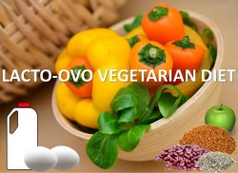
Micronutrient Case Project:
Lacto-Vegetarian Diet for a 16 year old female athlete distance track runner
By: Maria Scott, Amy Wagner, Cate Zuccarello

Slide 2
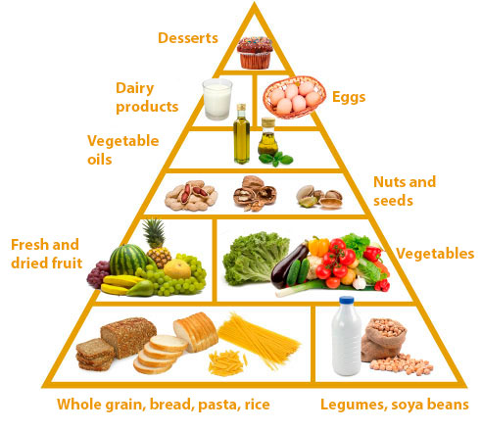
Background: Lacto-Vegetarian Diet
Lacto-Vegetarian Diet
Includes: Grains, vegetables, fruit, seeds & nuts, legumes, and dairy products (milk, cheese, yogurt, butter)

Slide 3
Background: Lacto-Vegetarian Diet
Excludes
Meats
Fish
Poultry
Eggs

Slide 4
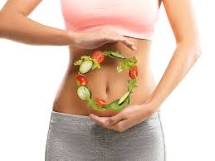
Background: Digestion
Lacto-vegetarians will…
Absorb 44% less dietary cholesterol
Synthesize 22% of cholesterol
Decreased Vitamin B12, erythrocyte superoxide dismutase activity

Slide 5
Background: Digestion Part II
Fiber → Regulating Digestion
Faster than non vegetarians
Drink Water
Prevent cramping & GI problems
Active Transport or Passive Diffusion
based on macronutrient

Slide 6
Female Athlete Triad
Syndrome dictated by 3 interconnected conditions:
Energy Deficiency
With or without Disordered Eating
Menstrual Disturbances
Amenorrhea
Bone Loss
Osteoporosis

Slide 7
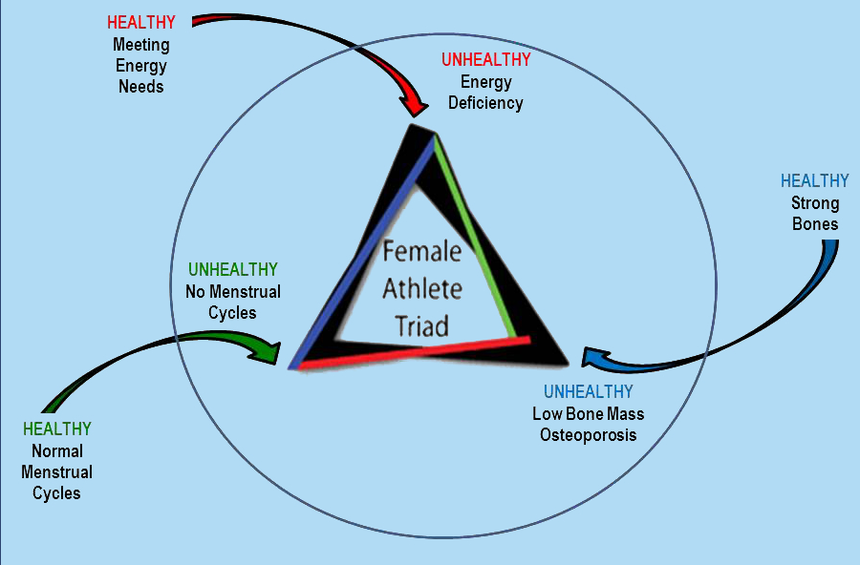
Female Athlete Triad

Slide 8
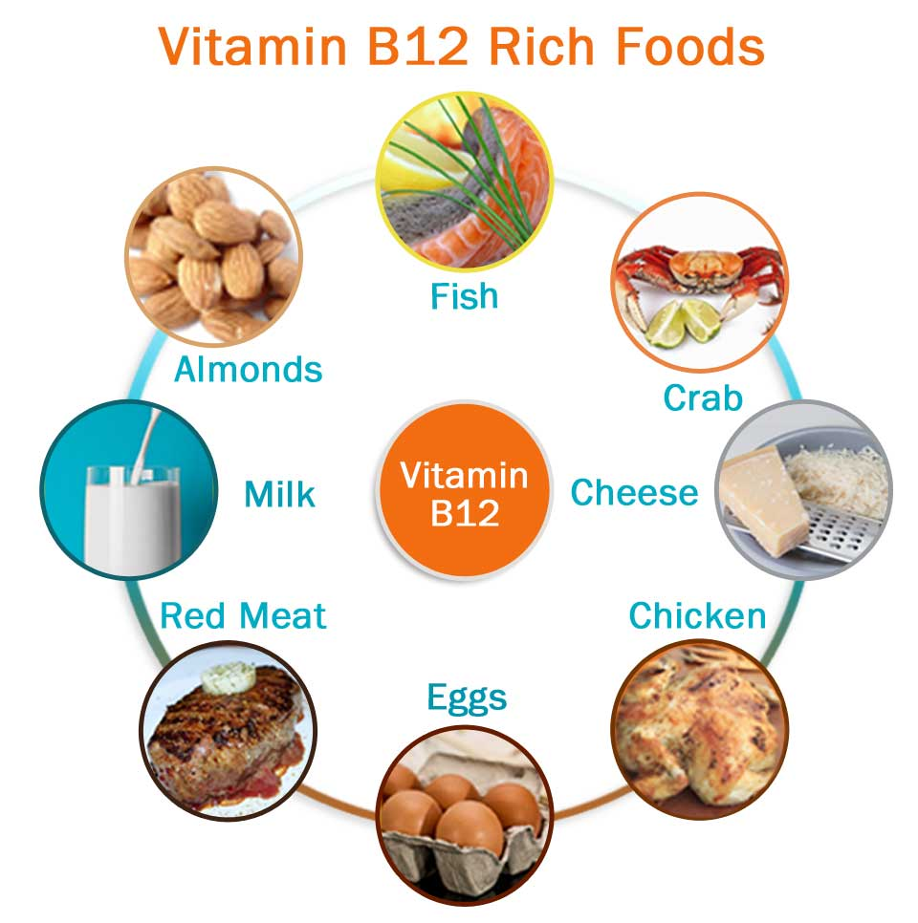
Vitamin B12 (Cobalamin)
Sources:
Fortified breakfast cereals
Cottage cheese (low fat)
Yogurt (low fat)
Lacto-Vegetarians
Have to increase intake by 180%

Slide 9
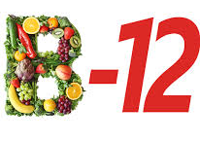
Vitamin B12 (Cobalamin)
RDA for 14-18 year old Female: 2.4 mcg/day
Lacto- Vegetarians: supplements of Vitamin B12 or eating foods with fortified Vitamin B12
No UL

Slide 10
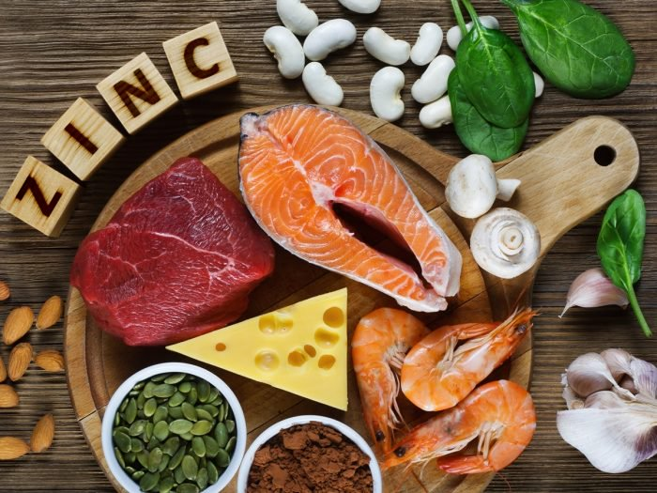
Zinc
Plant sources of zinc
Phytic Acid
Inhibit absorption
Lacto- Vegetarian Sources
Fortified cereals, beans, ricotta cheese
Have to increase intake by 150%

Slide 11
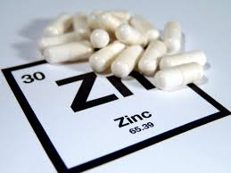
Zinc
RDA for 14-18 year old Female
9 mg/day
Vegetarians need to increase RDA by 50%
Her needs would be 13.5 mg/day
UL = 40 mg
Zinc needs increased when stress is high

Slide 12
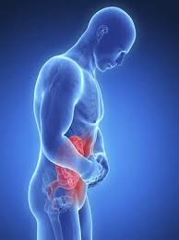
Deficiency of Zinc
Poor wound healing
Bone deformation
Abnormal hair/nails
GI disturbances
Dwarfism
Impaired folate and vitamin A absorption

Slide 13
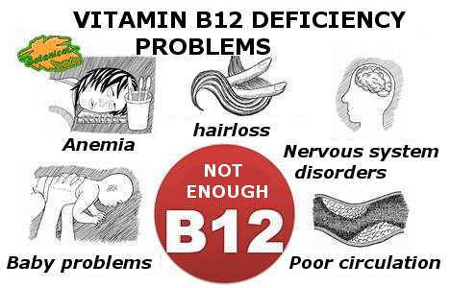
Deficiency of Vitamin B12
Pernicious anemia
Symptoms:
Megaloblastic macrocytic anemia
Fatigue

Slide 14
Deficiency of Vitamin B12
Sleeping issues
Numbness
Memory loss
Severe neurological disturbances

Slide 15
Test Methods and Assessments of Nutriture
Assessments of Zinc:
Mild deficiency
No good tests
Moderate to Severe deficiency
Serum/ Plasma Zinc
Looking into new tests

Slide 16
Test Methods and Assessments of Nutriture
Assessments of B12:
Serum vitamin B12 concentrations
Elevated plasma holotranscobalamin TCII concentrations
indication of vitamin B12 absorption
Measurement of methylmalonic acid

Slide 17
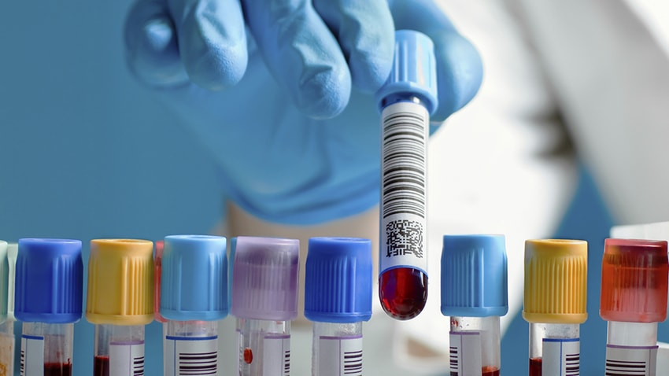
Test Methods and Assessments of Nutriture
Assessments of B12:
TCI, TCII, and TCIII
Breath test
Deoxyuridine suppression test
Schilling test
Urinary excretion

Slide 18
Recommendations
Balance between protein, fiber, and carbohydrate intake
Incorporate
Whole grains
Legumes
Nuts & Seeds

Slide 19
POP QUIZ!
1) Lacto-Vegetarian Diets include:
a) Meat, grains, vegetables, fruit
b) Fish, dairy, vegetables, fruit, legumes
c) Grains, vegetables, fruit, seeds & nuts, legumes, dairy products

Slide 20
POP QUIZ!
2) There is no UL for B12, but there is a UL for Zinc (T/F)
3) The three interconnected conditions of the Female Athlete Triad that render it a syndrome are ___________, ____________, _____________

Slide 21
References
Gropper SAS, Smith JL, Carr TP. Advanced Nutrition and Human Metabolism. 7th ed. Australia: Cengage Learning; 2018.
Davis, S. Vegetarian Diets and Digestion. 2018.

Slide 22
References
Vegetarian diet: how to get the best nutrition. https://www.mayoclinic.org/healthy-lifestyle/nutrition-and-healthy-eating/in-depth/vegetarian-diet/art-20046446. Updated March 14, 2016. Accessed April 23, 2018.

Slide 23
References
Wirnitzer, K, Seyfart, T, Leitzmann, C, et al. Prevalence in running events and running performance of endurance runners following a vegetarian or vegan diet compared to non-vegetarian endurance runners: the NURMI Study. In: Springerplus. Vol 5. 2016.

Slide 24
References
What is the Triad. http://www.femaleathletetriad.org/athletes/what-is-the-triad/. Accessed April 25, 2018.
Foster, M, Samman, S, Vegetarian Diets Across the Lifecycle: Impact on Zinc Intake and Status. In: Department of Human Nutrition, University of Otago. 2015

