Slide 1
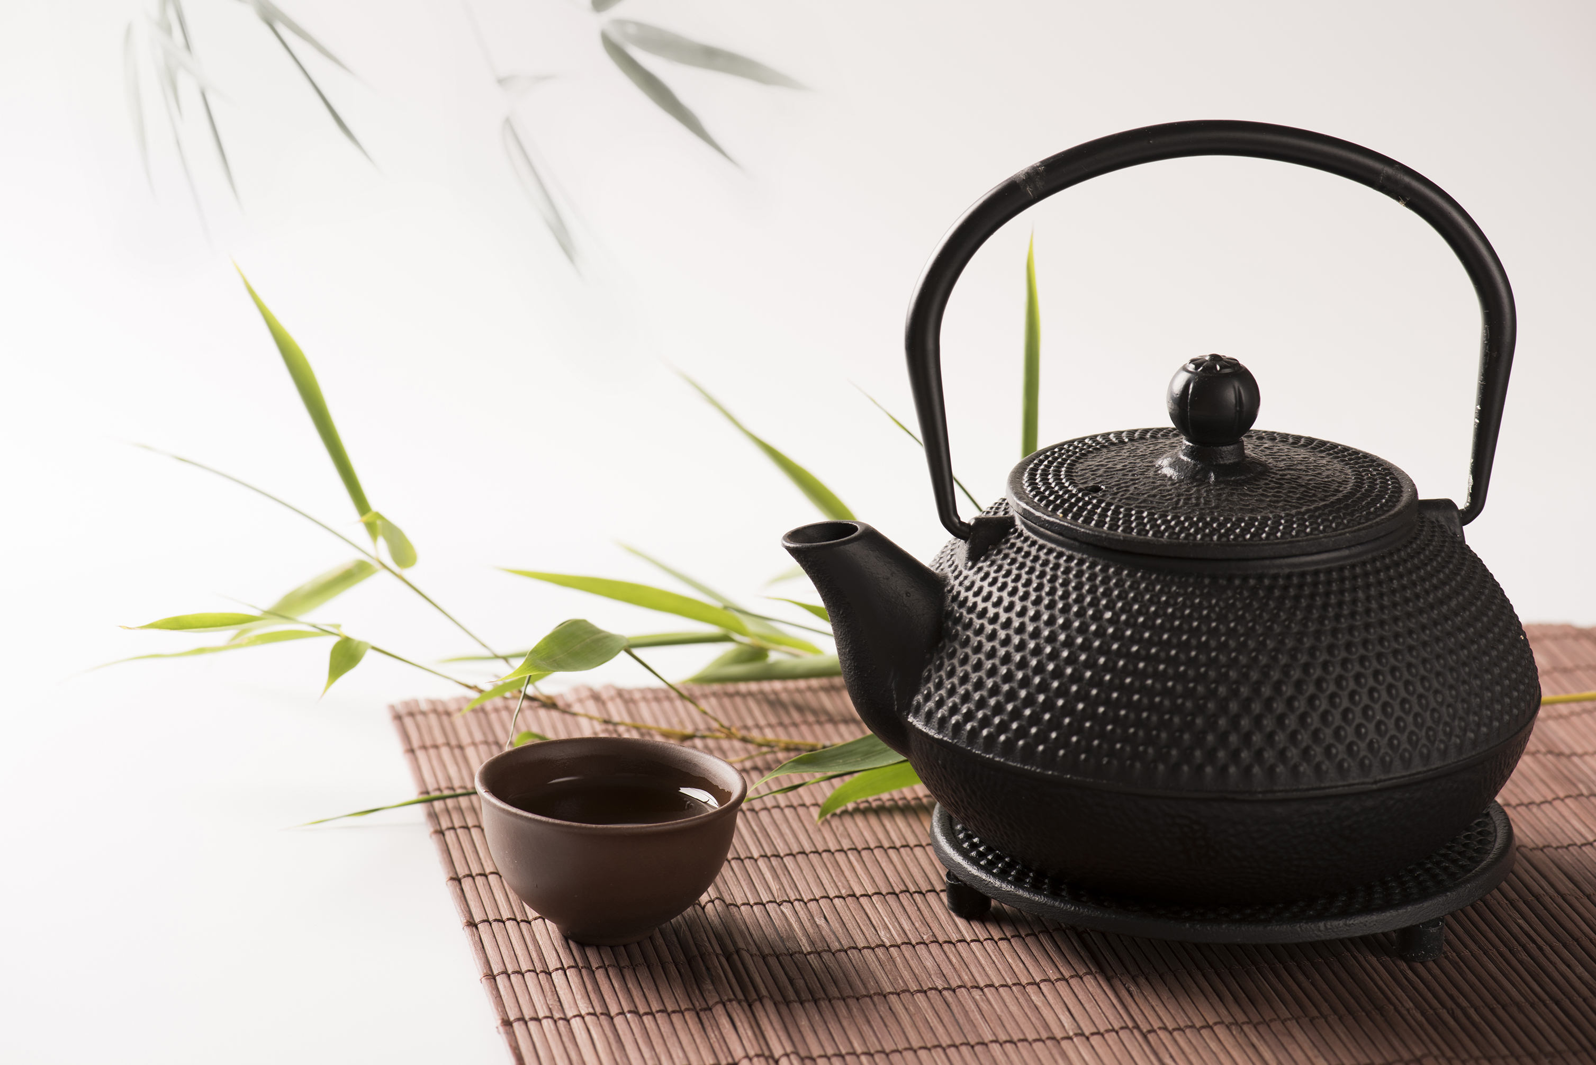
Herbal supplements effect on ameliorating biochemical and clinical features of elevated androgen levels (hyperandrogenism) in young women with Polycystic Ovary Syndrome (PCOS): A systematic review
By Amy Wagner, RD, LDN

Slide 2
Introduction
What is PCOS? - An endocrine disorder affecting women of reproductive ages.
History/ Background - 1935 - Stein and Leventhal initially describe PCOS as a syndrome.
Etiology & Pathogenesis - Not yet completely known. PCOS affects 6-12% of US Women.
(PCOS, 2020; PCOS and diabetes, 2020; Rosenfield & Ehrmann, 2016; Stein & Leventhal, 1935)
Notes:
Speaking Points:
What is PCOS: PCOS is a lifelong chronic disease and hormonal disorder and affects the endocrine system of women or those who have female reproductive organs, significantly during reproductive.
History/ Background: In 1935 PCOS was when PCOS was initially described as being a syndrome by Stein and Leventhal, involving the presence of polycystic ovaries and oligomenorrhea along with symptoms such as hirsutism, acne, overweight and obesity
Pathogenesis: The etiology and pathogenesis of PCOS is unknown and further research is needed to understand why PCOS affects six to twelve percent (approximately five million women) of reproductive-aged women in the United States alone.

Slide 3
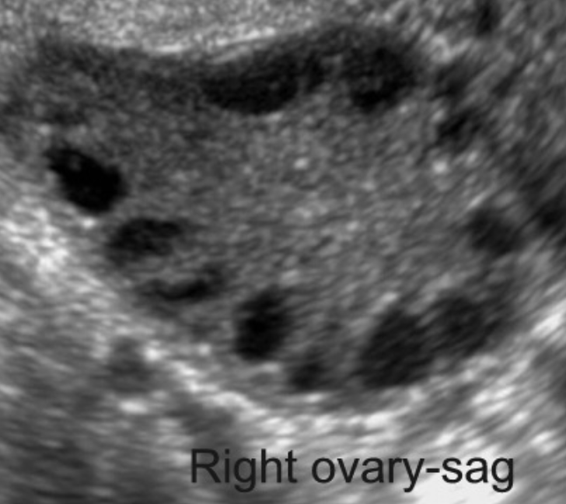
PCOS Diagnostic Criteria
Must meet 2 of the 3 following Rotterdam Criteria
1. Polycystic Ovaries – Ovaries that have multiple cysts or fluid-filled sacks on or in the ovaries causing them to be enlarged. (Pictured).
2. Oligomenorrhea - Irregular periods (missing or skipping periods, and periods last longer or shorter than the average cycle length). This criteria also including periods that are extraordinarily heavy.
3. Hyperandrogenism - High levels of androgens in women which may present as high levels of testosterone in the blood, hirsutism (excessive facial, back, and chest hair growth), alopecia, acne, central obesity, etc.
(PCOS, 2020; Oakley, 2014)
Notes:
Speaking Points:
→ Diagnosis of PCOS must meet 2 of the 3 following Rotterdam criteria:
Polycystic Ovaries- Clusters or accumulations of cysts or fluid filled sacs in or on ovaries causing enlargement of the ovaries. This can be identified via a pelvic ultrasound. These cysts are commonly referred to as a ”string of pearls” due to their appearance.
Oligomenorrhea- Irregular periods (missing or skipping periods, and periods last longer or shorter than the average cycle length). This criteria also including periods that are extraordinarily heavy. This can be identified through physical exams, blood tests, observations of menstrual cycle, and pelvic ultrasounds.
Hyperandrogenism- High levels of androgens in women which may present as high levels of testosterone in the blood, hirsutism (excessive facial, back, and chest hair growth), alopecia, acne, and central obesity. Elevated androgens can be identified via blood tests, and through observations of physical, clinical presentations in patients. Some biochemical labs that can show hyperandrogenism include serum testosterone including free and total testosterone, DHEA & DHEAS (a types of androgen or male sex hormone).

Slide 4
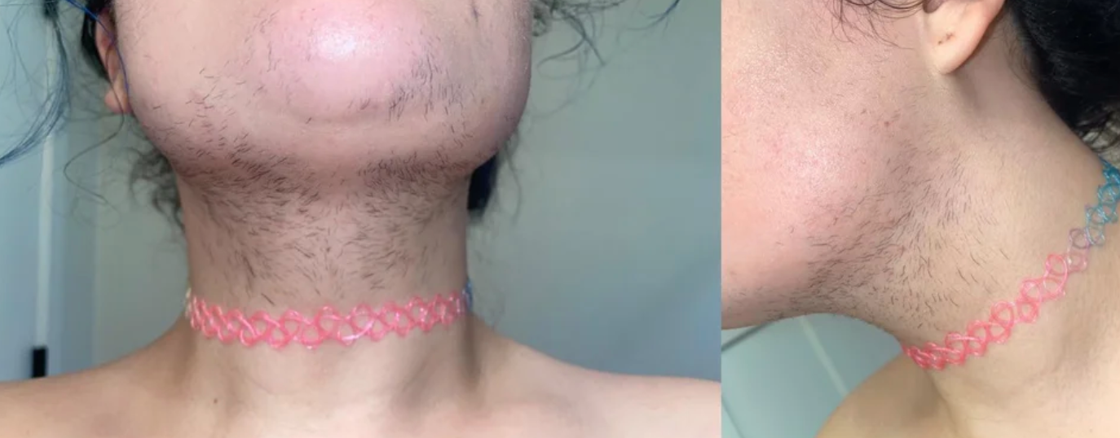
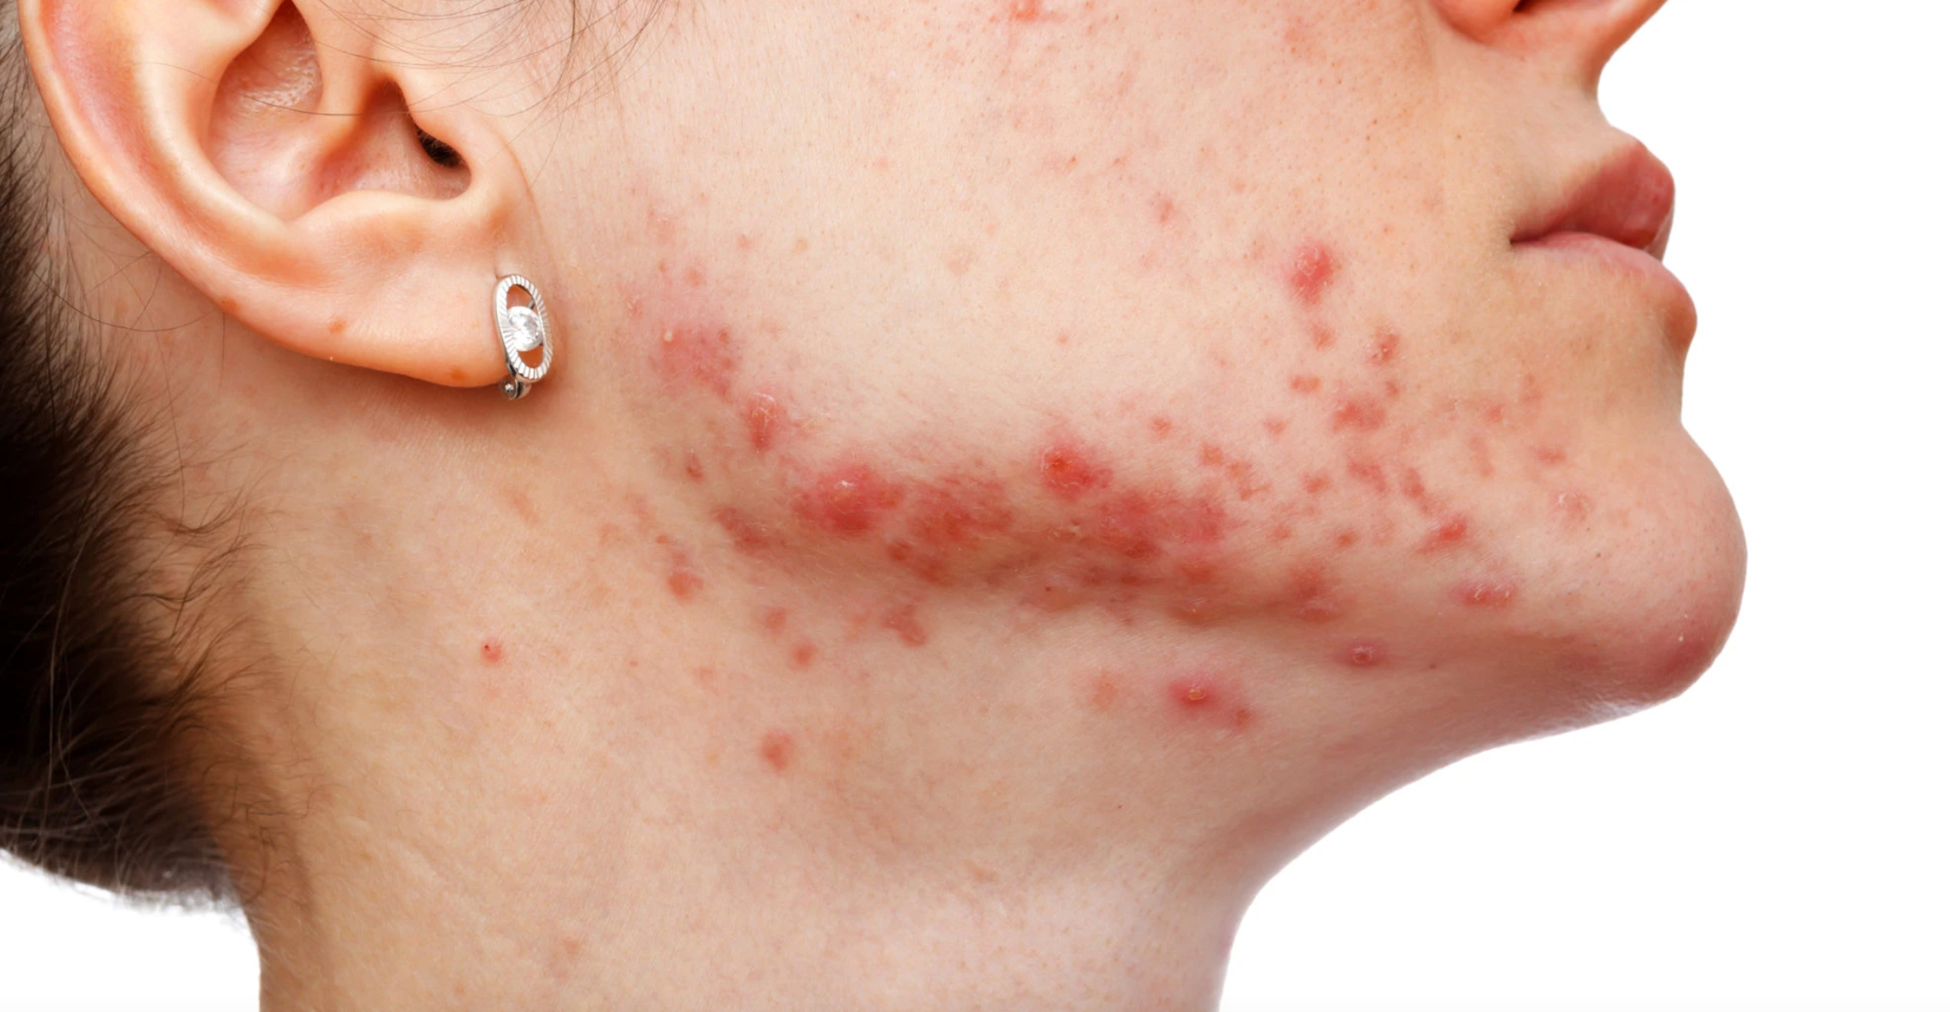
Hirsutism
Hormonal Acne

Slide 5
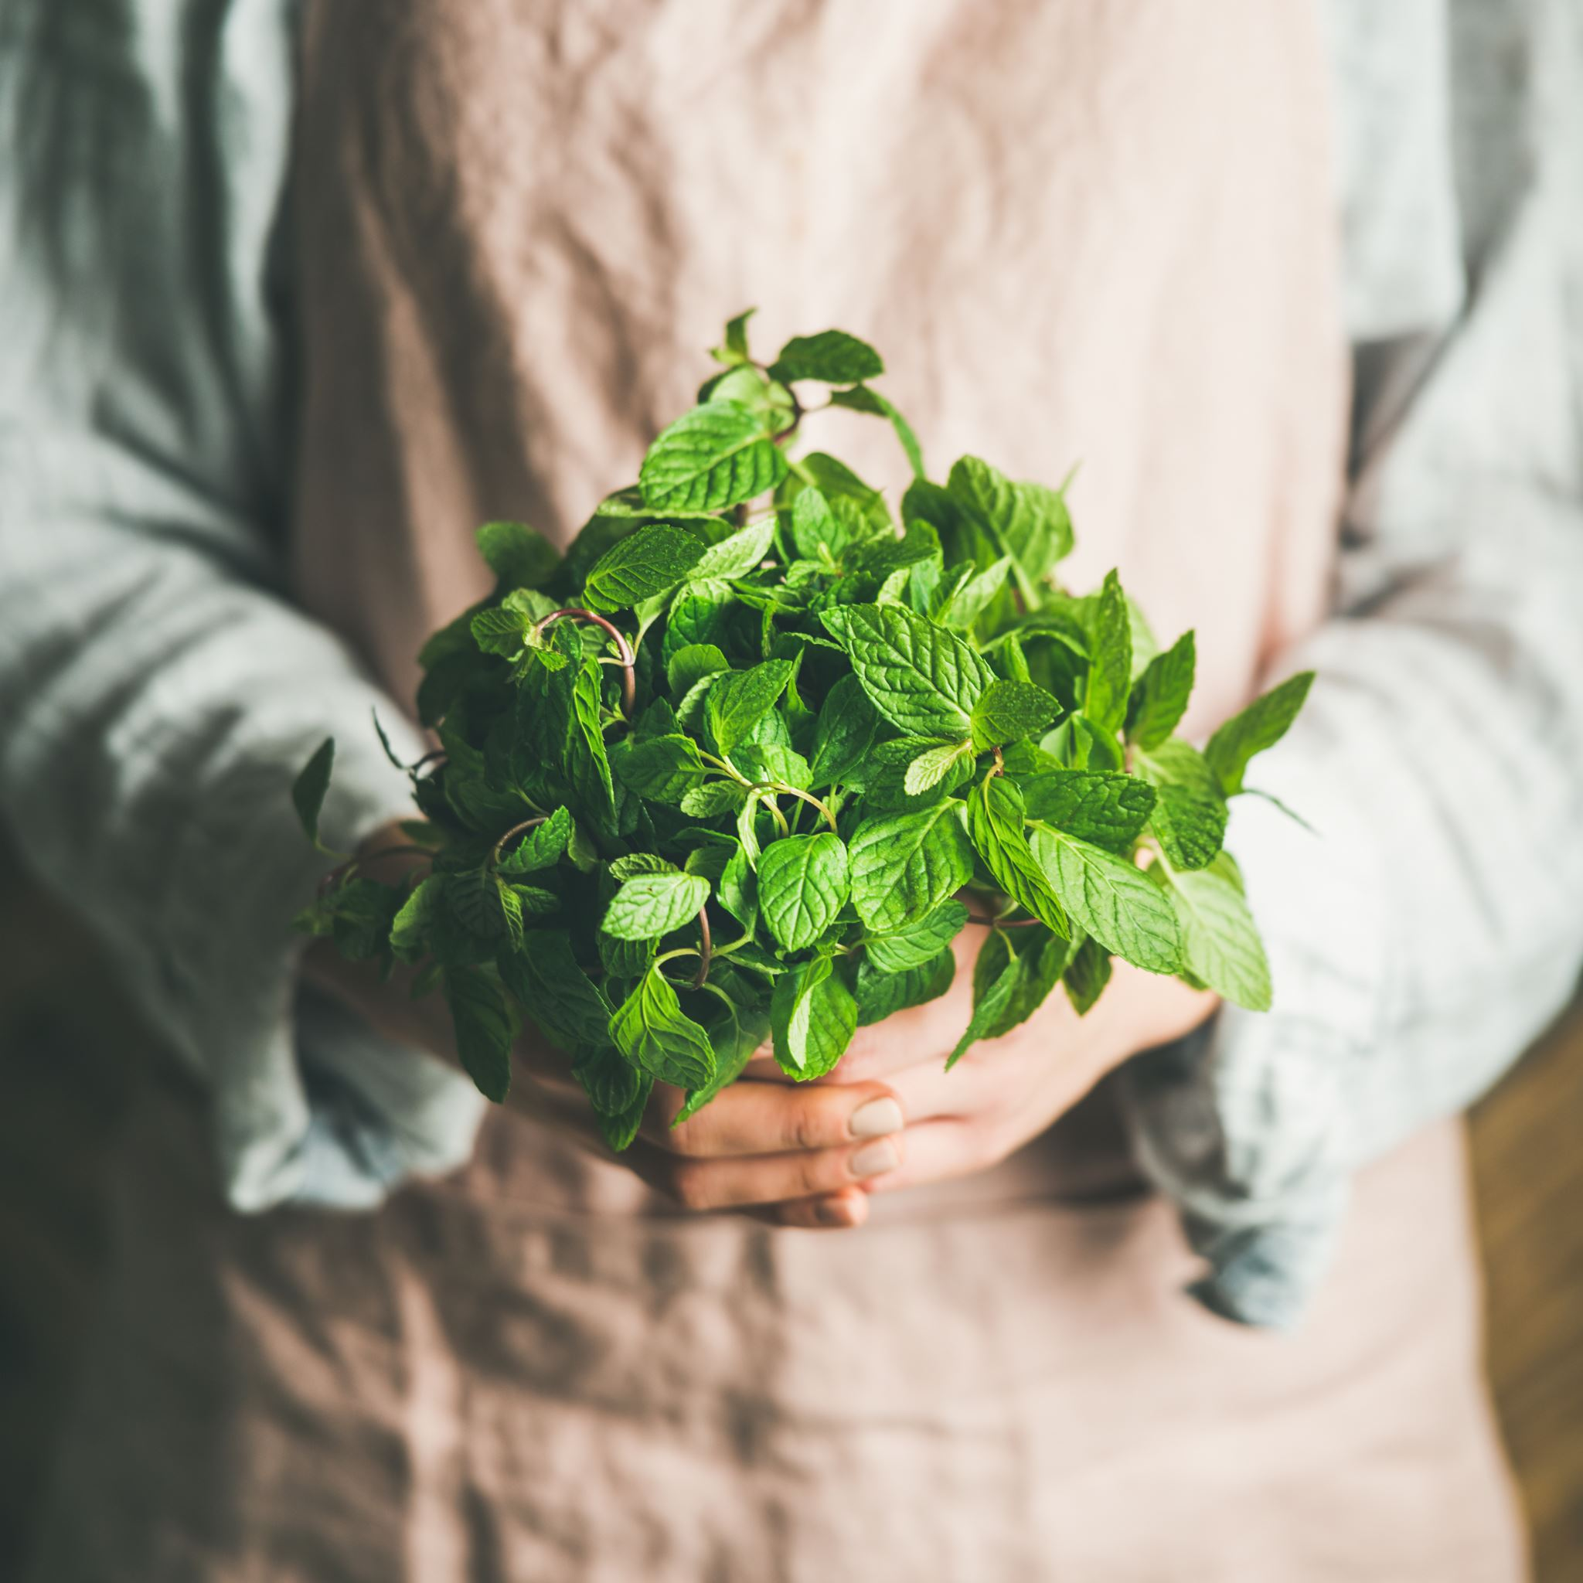
Research Question
What is the effect of herbal supplements on reducing androgens in young women with Polycystic Ovary Syndrome (PCOS)?

Slide 6
Methods
Electronic Literature Search
Databases Used: Academic Search Ultimate, Agricola, Biological Abstracts, E- Journals, MEDLINE Complete, Alt Health Watch and CINAHL Complete through EBSCO; & Google Scholar
Participants: PCOS Women aged 18-42 & treated with various herbal supplements
Quality Criteria Checklist
Purpose: The aim of this systematic review is to identify what effect herbal supplements have on reducing androgens in young women with PCOS.
Notes:
Methods: An electronic literature search was conducted during May and June of 2021 to identify studies published between 2004 and 2021via the following databases: Academic Search Ultimate, Agricola, Biological Abstracts, E- Journals, MEDLINE Complete, Alt Health Watch and CINAHL Complete through eBook Clinical Collection (EBSCO), as well as Google Scholar. Participants were women with PCOS aged 18-42 and treated with various herbal supplements. Articles included in this systematic review were critically appraised via the Quality Criteria Checklist.
The aim of this systematic review is to identify what effect herbal supplements have on reducing androgens in young women with PCOS.

Slide 7
Search Strategy
MeSH Terms | “AND” Terms | Related Lab Values
PCOS Polycystic ovarian syndrome Polycystic ovary syndrome Hirsutism Women | Spearmint Baicalin Lavender Licorice Glabridin | Testosterone Androgen Androgens Hyperandrogenism
Notes:
These search terms were use in various combinations to identify quality articles to be included in this review.

Slide 8
Inclusion & Exclusion Criteria
Inclusion Criteria | Exclusion Criteria
Species: Human Gender: Female Age: Young women Nutrition Related Problem/ Condition: Polycystic Ovary Syndrome (PCOS) Study Design Preference: Randomized Controlled Trials, Randomized Clinical Trials, placebo controlled randomized studies, non-controlled trials, before and after studies, and experimental studies Year Range: 2004-2021 Language: English Full text accessibility: Yes International Studies (including US Studies) Treatments: herbal treatment alone or drug/ medicine treatment along with herbal treatments were included | Species: Animal studies (such as rat studies/models) Genders: any gender other than female Age: children, postmenopausal women Study Design/ Article type: review articles, systematic reviews, meta-analysis, literature reviews, academic review articles, dissertation papers, handbooks, academic articles without a study or trial, textbooks Year Range: prior to 2004 Language: Articles not published in English No accessibility to full text articles/studies Articles not on the subject of hirsutism and hirsutism treatment. Treatment: herbal treatments combined with laser hair removal treatments were excluded.
Notes:
Pre-defined inclusion and exclusion criteria were used to select studies for this review to minimize bias from the researcher during the selection process. To minimize bias, all studies that met the inclusion criteria and did not meet the exclusion criteria were all reviewed regardless of the effectiveness the herbal remedies had on reducing androgens in women with hirsutism. Also, articles were included in the review regardless of their Quality Criteria Checklist ratings.

Slide 9
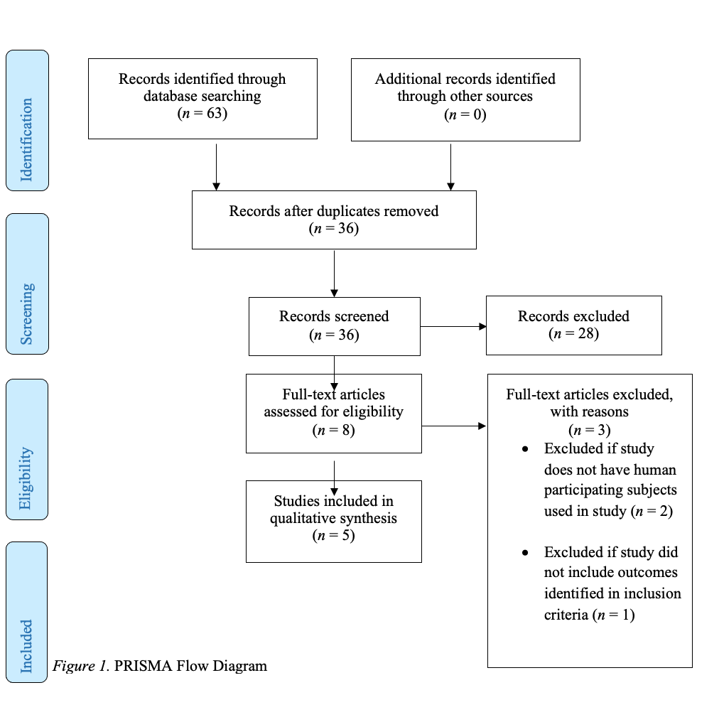
Results: PRISMA Diagram
Notes:
A total of sixty-three articles were found through various databases across EBSCO, and throughout Google Scholar. A full list of databases that were searched through EBSCO is recorded under the Search Strategy section of this systematic review.
A total of twenty-seven duplicate studies were removed and the remaining thirty-six articles were screened. Of the thirty-six screened articles, twenty-eight were excluded because they did not meet the inclusion criteria. Of the thirty-six screened articles, eight were eligible to be analyzed to determine whether or not they were appropriate to be included in this study. Of the eight full text articles analyzed, three of them were excluded due to the following reasons: studies were excluded if they did not have any human participating subjects (n = 2); studies were excluded if they did not include outcomes identified in the inclusion criteria (n = 1).
This left a total of five viable articles to be analyzed and included in this systematic review.
Two of the five articles are Randomized Controlled Trials (RCT) (Ainehchi et al., 2020; Grant, 2010) and the remaining three articles are Experimental Studies (Akdogan et al, 2007; Armanini et al., 2007; Luan & Sun, 2015).

Slide 10
Results: Included Studies
Articles | What They Evaluated
Ainehchi et al. (2020) RCT; + | Evaluated the effect an herbal mixture plus clomiphene citrate (CC)
Grant (2010) RCT; + | Expanded on previous research in order to evaluate whether or not spearmint tea can reduce androgen levels and improve clinical features of PCOS in PCOS women.
Akdogan et al. (2007) Experimental Study; Ø | Evaluated the effect spearmint tea had on androgen levels in women with hirsutism and PCOS.
Armanini et al. (2007) Experimental Study; Ø | Evaluated the effect spironolactone plus licorice had on androgen levels in women with PCOS.
Luan & Sun (2015) Experimental Study; Ø | Evaluated what effect glabridin had on testosterone levels and hirsutism in women with PCOS.
Notes:
Both RCT’s were awarded positive ratings on the Quality Criteria Checklist, while the 3 Experimental Studies were awarded neutral ratings on the Quality Criteria Checklist.
The first RCT by Ainehchi et al. (2020) evaluated the effect an herbal mixture plus clomiphene citrate (CC); a drug used to treat female infertility) had on treating symptoms of PCOS.
The second RCT by Grant (2010) expanded on previous research in order to evaluate whether or not spearmint tea can reduce androgen levels and improve clinical features of PCOS in PCOS women.
The first experimental study by Akdogan et al. (2007), evaluated the effect spearmint tea had on androgen levels in women with hirsutism and PCOS.
The second experimental study by Armanini et al. (2007) evaluated the effect spironolactone (SP; a drug which is an “antagonist of mineralocorticoid and androgen receptors”) plus licorice had on androgen levels in women with PCOS.
Finally, the third experimental study by Luan and Sun (2015) evaluated what hypoglycemic effects glabridin (from licorice) had on women with PCOS, but during their study, they were able to evaluate what effect glabridin had on testosterone levels and hirsutism in women with PCOS.

Slide 11
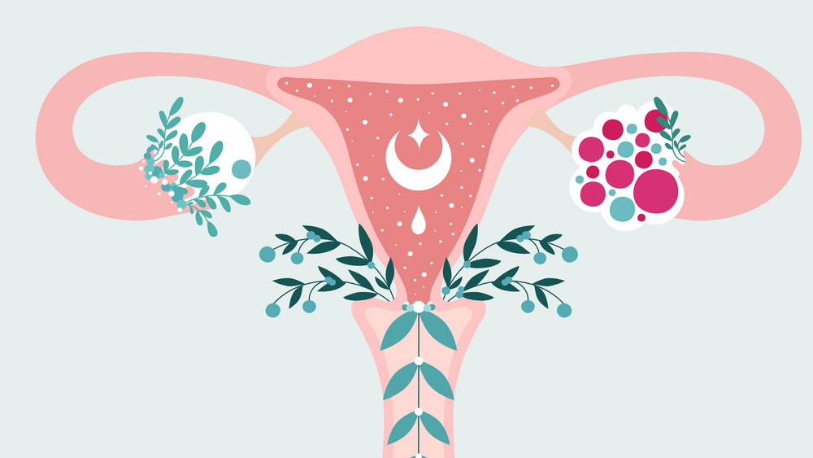
Themes and Discussion

Slide 12
Biochemical Androgen Testing
Articles | Serum testosterone | Total testosterone | Free Testosterone | DHEAS
Ainehchi et al., 2020 RCT |  | Herbal mixture treatment x 3 months → significant decrease Herbal mixture + 50-150mg CC treatment x 3 months →no significant decrease | Herbal mixture + 50-150mg CC treatment x 3 months → no significant decrease Herbal mixture + 50-150mg CC treatment x 3 months → significant decrease
Akdogan et al., 2007 Experimental Study |  | 250mL spearmint tea 2x/day x 5 days during follicular phase → no significant decrease | 250mL spearmint tea 2x/day x 5 days during follicular phase → significant decrease | 250mL spearmint tea 2x/day x 5 days during follicular phase → no significant decrease
Armanini et al., 2007 Experimental Study |  | 100gm spironolactone plus 3.5gm licorice 2x/day x2 months → no significant changes | 100gm spironolactone plus 3.5gm licorice 2x/day x2 months → no significant changes
Grant, 2010 RCT |  | Spearmint tea 2x/day x 1 menstrual cycle → significant decrease | Spearmint tea 2x/day x 1 menstrual cycle → significant decrease | Spearmint tea 2x/day x 1 menstrual cycle → no significant decrease
Luan & Sun, 2015 Experimental Study | 10 μM of glabridin /day x 12 months → significant decrease
Herbal supplements can improve biochemical androgen levels in young women with PCOS.
Notes:
All five studies analyzed data on how an herbal supplement affects biochemical androgen levels. Androgens that were analyzed through biochemical testing across all five studies include testosterone, free testosterone, total testosterone, and DHEAS. Four of the five studies found a statistically significant decrease in androgen levels in young women with PCOS after treatment of herbal supplements (herbal supplements treated with or without medications) including studies done by Ainehchi et al. in 2020, Akdogan et al. in 2007, Grant in 2010, and Luan and Sun in 2015.
The first study found that women who were treated with an herbal mixture (700 mg herbal mixture composed of Mentha spicata, Zingiber officinale, Cinnamomum zeylancium, and Citrus sinensis- sweet orange group) daily for three months had a statistically significant decrease in total testosterone levels after treatment (p = .022) as compared to the women treated with only clomiphene citrate (CC), but did not result in a statistically significant decrease in free testosterone levels after treatment (p = .204) as compared to women treated with only CC (Ainehchi et al., 2020). After treatment, free testosterone was significantly decreased in women who were treated with the herbal mixture plus 50-150mg CC daily for three months (p < .001) but did not result in a statistically significant decrease in total testosterone levels after treatment (p = .099) as compared to women treated with only CC (Ainehchi et al., 2020).
The second study found that PCOS young women who were treated with for five days with 250mL of herbal tea consisting of M. Spicata (spearmint) twice a day over the course of 5 days during their follicular phase of their menstrual cycles, had a statistically significant decrease in free testosterone (p < .05), but no significant decrease in total testosterone (p > .05) nor DHEAS (p > .05) after treatment (Akdogan et al., 2007).
The third study did not find any statistically significant changes in total testosterone (p > .05) and free testosterone (p > .05) after treatment of 100gm spironolactone plus 3.5gm licorice twice a day over a duration of two months in young women with hirsutism and PCOS (Armanini et al., 2007).
The fourth study found that young women with PCOS had a statistically significant decrease in both free testosterone (p < .05) and total testosterone (p < .05) levels but not DHEAS (p >.05) levels after the treatment of spearmint tea (unspecified dose) twice a day over the course of one average menstrual cycle length (Grant, 2010).
Finally, the fifth study found that young women with PCOS treated with 10 μM of glabridin (a licorice extract) per day had a statistically significant decrease in serum testosterone levels (p = .04) after twelve months of treatment Luan & Sun, 2015).
Overall, most of the studies in this systematic review found that herbal supplements can help lower biochemical androgen levels in young women with PCOS including, serum testosterone, free testosterone, total testosterone, and DHEAS. Therefore, the data collected from this systematic review supports the notion that herbal supplements can improve biochemical androgen levels in young women with PCOS.

Slide 13
Clinical Features & Manifestation of Hyperandrogenism
Article | Hirsutism | Acne
Ainehchi et al., 2020 RCT | Herbal mixture treatment or herbal mixture + 50-150mg CC treatment x 3 months → statistically significant improvement | Herbal mixture treatment or herbal mixture + 50-150mg CC treatment x 3 months → statistically significant improvement
Grant, 2010 RCT | Spearmint tea 2x/day x 1 menstrual cycle → statistically significant decrease in subjective hirsutism scores (DQLI) but not in objective hirsutism scores (Ferriman-Gallwey)
Luan & Sun, 2015 Experimental Study | 10 μM of glabridin /day x 12 months → statistically significant decrease in subjective ”Hirsutism Scores” but not objective hirsutism scores (Ferriman-Gallwey)
It is inconclusive to determine the effect herbal supplements have on improving clinical manifestations of hyperandrogenism in young women with PCOS.
Notes:
Three of the five studies analyzed clinical features and manifestations of hyperandrogenism in young women with PCOS including Ainehchi et al. (2020), Grant (2010), and Luan and Sun (2015). Clinical features include acne and hirsutism.
The study done by Ainehchi et al. (2020), found that young women with PCOS who were treated with an herbal mixture (previously defined), or an herbal mixture plus 50-150mg CC daily for three months had a statistically significant improvement in both hirsutism (herbal only treatment (p = .001); herbal plus CC (p = .001) treatment) and acne (herbal only treatment (p = .008); herbal plus CC (p < .001)).
The study done by Grant (2010) found that young women with PCOS, treated with spearmint tea (unspecified dose) twice a day over the course of one average menstrual cycle length, had a statistically significant decrease in hirsutism based on a subjective assessment (modified DQLI) (p < .05) after treatment but did not have a statistically significant improvement in hirsutism based on an objective assessment score (Ferriman-Galwey scores) (p = .12) after treatment.
Finally, the study done by Luan and Sun (2015) found that young women with PCOS, treated with 10 μM of glabridin per day for a duration of 12 months, had a statistically significant decrease in “Hirsutism Scores” (p value not listed), but did not have a statistically significant decrease in hirsutism based on objective Ferriman-Gallwey scores (p = .11).
Overall, there is not enough information and data to determine whether or not herbal supplements can improve clinical features and manifestations of hyperandrogenism such as hirsutism and acne based on the studies from this systematic review. Therefore, at this time, it is inconclusive to determine the effect herbal supplements have on improving clinical manifestations of hyperandrogenism in young women with PCOS.

Slide 14
Discussion Continued
All studies agreed, to some degree, that elevated androgen levels in young women with PCOS can be decreased by the treatment of various herbal supplements
(Ainehchi et al., 2020; Akdogan et al., 2007; Armanini et al., 2007; Grant, 2010; Luan & Sun, 2015).
Notes:
All studies agreed, to some degree, that elevated androgen levels in young women with PCOS can be decreased by the treatment of various herbal supplements
It’s difficult to compare findings from each study to one another because they do not study the exact same herbal supplement treatment. Some studies have combined treatments of several herbs, some have herbal supplements with medications, and some have one isolated herb as a supplement (such as spearmint alone).
This is a major reason why more studies need to be conducted to determine what effect individual or isolated herbal supplements have on androgen levels in women with PCOS.

Slide 15
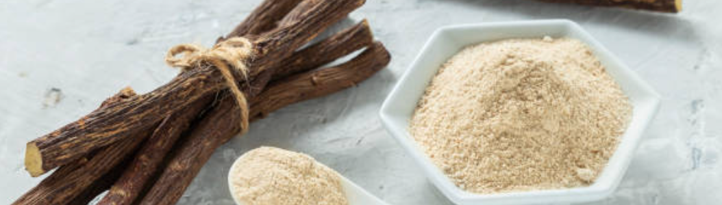
Discussion: Strengths & Limitations
Strengths – 2 RCT, blinding, same population and age across studies,
Limitations – Majority of studies were experimental studies, short treatment periods, small sample sizes, subjective data was collected, limited studies included in review, several mixed treatments.
Notes:
Only two of the five studies in this systematic review were gold standard RCT’s both of which used randomization and blinding to reduce the chance of bias (Ainehchi et al., 2020; Grant, 2010). The Both were rated as strong studies with positive ratings from the QCC.
The remaining three studies were experimental studies, all of which resulted in neutral (Ø) ratings from the QCC due to the majority of the three studies lacking clarity (Akdogan et al., 2007; Armanini et al., 2007; Luan & Sun, 2015).
Major limitations to most of the studies in this review were that they had small sample sizes and too short of treatment periods to determine accurate effects of the relationship of the respected treatments on androgen levels (Ainehchi et al., 2020; Akdogan et al., 2007; Armanini et al., 2007; Grant, 2010).
The limitation of the last study was that there was no control group to compare results of the treatment (Luan & Sun, 2015).
Another limitation was that some studies obtained data on acne and hirsutism subjectively, which provides data that is not as reliable and valid as objectively measured data (Ainehchi et al., 2020; Grant, 2010).
An overall limitation of the systematic review was that the inclusion and exclusion criteria resulted in only five studies fitting the criteria to be reviewed and included in this systematic review. Because studies were limited to English, this could mean that quality studies were excluded from being reviewed and adding quality information to this review.
Another limitation was that multiple herbal remedies were included in the review and the search was not limited to one herb’s effect on androgens because there were not enough human studies on a single herb. Therefore, the search broadly evaluated the effect several herbs had on androgens rather than looking at several studies showing data on one herb’s effect on androgens in this population.
A strength of this review was that all study populations consisted of young (premenopausal) women with PCOS who presented with elevated androgens.

Slide 16
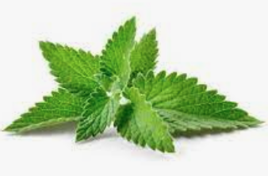
Conclusion
Conclusion - Herbal supplements can significantly lower biochemical androgen levels and can significantly improve clinical features of elevated androgens in young women with PCOS.
Grade - II (Fair)
Further Research - Human subjects with PCOS & isolated, individual herbal supplement treatment on this population.
Notes:
Conclusion: Based on the studies from this systematic review, it is evident that herbal supplements (spearmint, ginger, cinnamon, sweet orange groups, glabridin) can significantly lower biochemical androgen levels and can significantly improving clinical features (acne and hirsutism) of elevated androgens in young women with PCOS.
It is impossible at this time to give a definitive answer on what supplement, how much, and for how long women with PCOS would need treatment for to ameliorate elevated androgen symptoms due to the fact that the treatment was not identical across all studies included in this review. For example, some studies had an intervention consisting of spearmint, while others had an intervention consisting of a mix of several herbal supplements.
The conclusion resulted in a final grade of II (fair) overall. Further research must be conducted on human subjects with PCOS. Further research should also include studies that look at isolated, individual herbal supplement treatment on this population without medicine or multiple herbal components in one study or review

Slide 17
Thank you!

